Slide 1
Music Genre
Classification
Team Members:
Bikash Pokharel
Shambhu Adhikari

Slide 2
Table of Content
Objective of the Project
Tools and Techniques used
Project Deliverables
Methodology
Data Description
Predicted Output Snipper
Hiphop,
Classical
Blues
Notes:
Deliverables (i.e., a list of items that will be submitted upon completion, and their relevance to the stated objectives)

Slide 3
Objectives
There are many music genre classification systems online but there are very less projects that classify genre using support vector machine and K-nearest neighbours. So we are using this two approach for genre classification. This project:
Predict the Genre of audio songs(blues, classical, hiphop, rock, metal, jazz, reggae, rock, pop, disco) using SVM and k-nearest neighbour.
Implement Convolution Neural Network with ReLU activation, softmax output, and cross entropy loss.
Notes:
Statement of project objectives

Slide 4
Tools and Techniques
Torch: For audio manipulation. IT is a deep learning library of python which makes most for our audio manipulation jobs easier and flexible that hard core code.
Librosa: For audio representation of all audio datasets
Pickle: Due to heavy volume of data, this library is used for serialized objects to files on disk and deserialized back into program at runtime.
Other libraries: pandas, numpy, sklearn, etc
Notes:
Approach (i.e., what tools and techniques you intend to use to achieve the project objectives)
blues - classical - country - disco - hiphop - jazz - metal - pop - reggae - rock
serialized to files on disk and deserialized back into the program at runtime

Slide 5
Deliverables
Genre prediction code file
Different music genre mp3 files
Train Model
Data
Notes:
Deliverables (i.e., a list of items that will be submitted upon completion, and their relevance to the stated objectives)

Slide 6
Evaluation Methodologies
For evaluating this project we used these two approaches:
Used accuracy as a main metrics where we will check percentage of predicted labels which matched their true labels of audio samples.
We will also be using confusion matrices for getting the performance of our best model
Notes:
Evaluation methodology (i.e., how can I check to see whether you have achieved the objectives or not.)

Slide 7
Data Description
For the raw data we used GTZAN online dataset which was prepared for genre classification research paper. The size of data is 1.2GB and it has 1000 audio tracks where each track is 30 second long. It contains total of 10 genres and there are 1000 songs of each genre of .wav file.
For the training dataset. We will be using 100 sample of un-augmented data each of our cross validation and test sets.
This is our source of Dataset Link
Notes:
Evaluation methodology (i.e., how can I check to see whether you have achieved the objectives or not.)

Slide 8
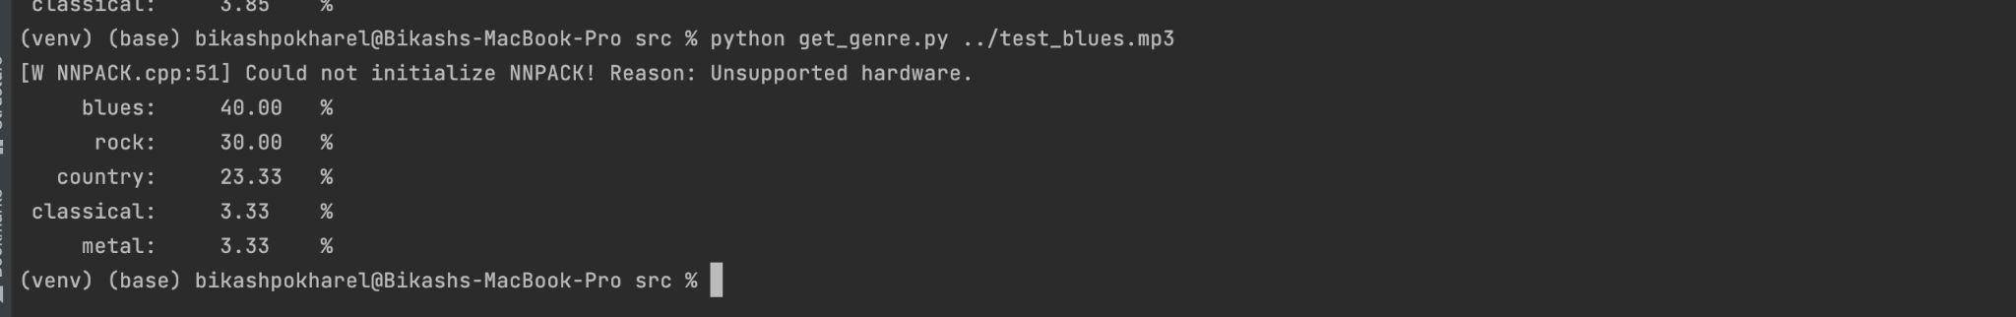
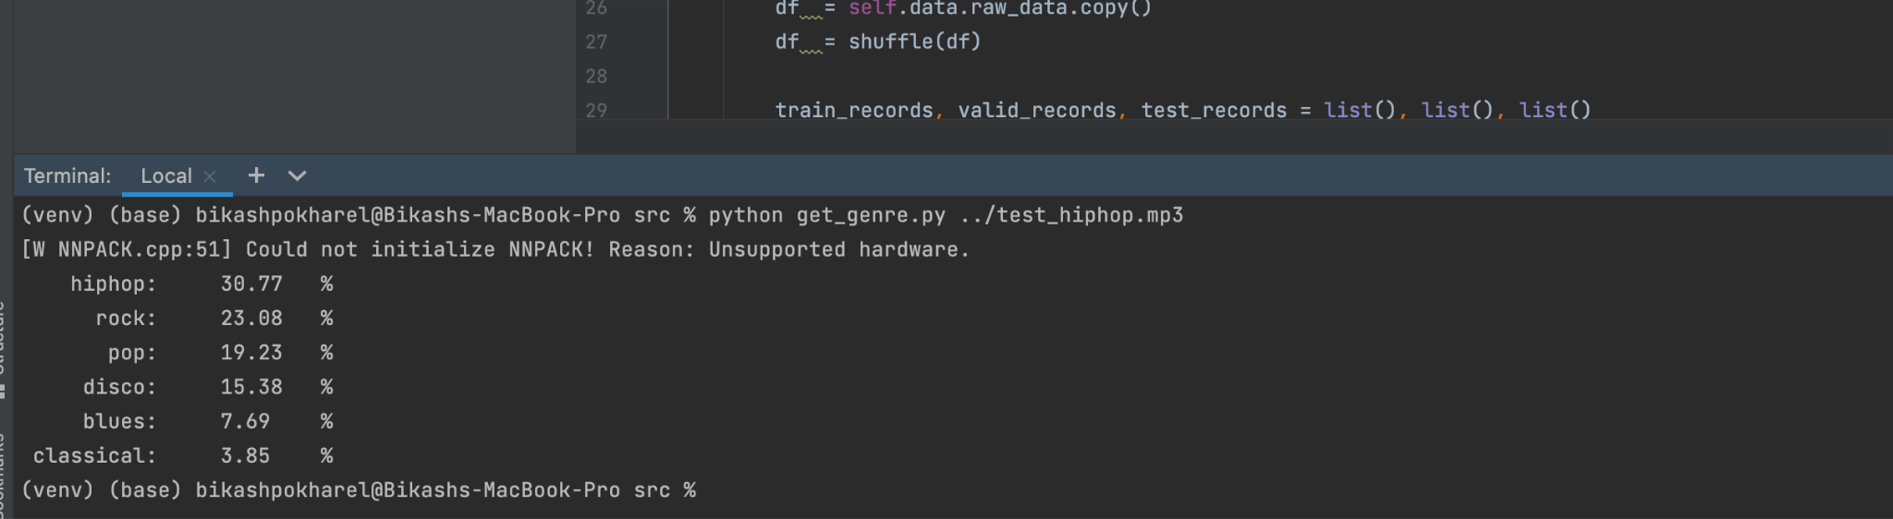
Output Snippets
Notes:
Evaluation methodology (i.e., how can I check to see whether you have achieved the objectives or not.)

Slide 9
Output Snippets
Notes:
Evaluation methodology (i.e., how can I check to see whether you have achieved the objectives or not.)

Slide 10
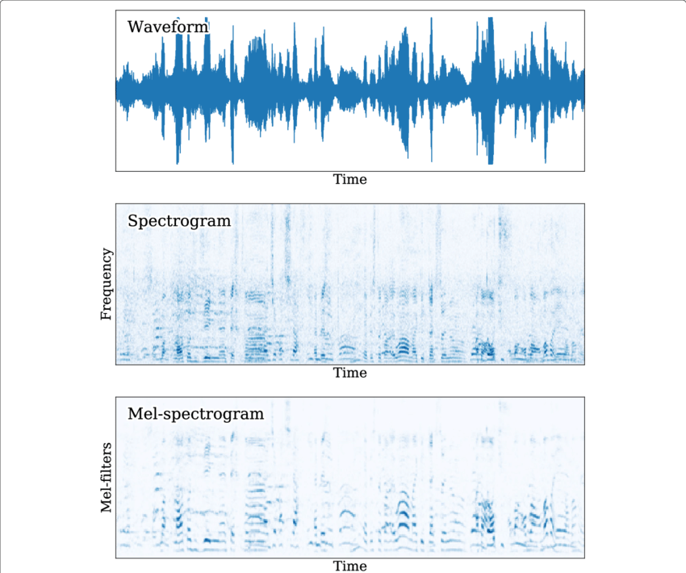
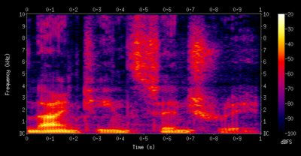
Mel Spectrogram Snippets
Notes:
Evaluation methodology (i.e., how can I check to see whether you have achieved the objectives or not.)

Slide 11
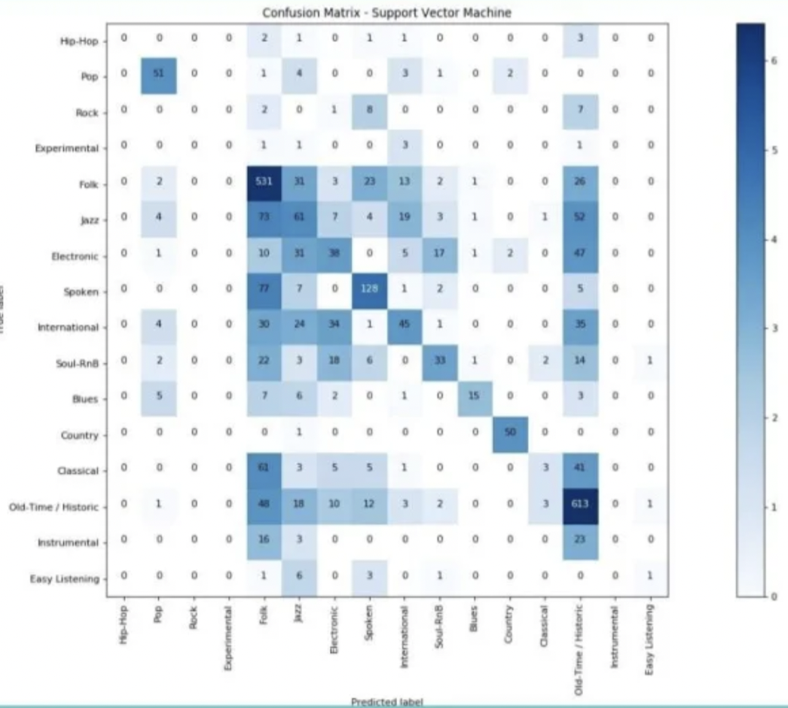
Output: Confusion Matrix
Notes:
Evaluation methodology (i.e., how can I check to see whether you have achieved the objectives or not.)

Slide 12
References
https://en.wikipedia.org/wiki/Support-vector_machine
https://data-flair.training/blogs/python-project-music-genre-classification/
http://cs229.stanford.edu/proj2018/report/21.pdf
https://towardsdatascience.com/music-genre-classification-with-python-c714d032f0d8
Notes:
Evaluation methodology (i.e., how can I check to see whether you have achieved the objectives or not.)

